Slide 1





Next Gen Employability Program
Full Stack Web Development with AI Tools
Team Details – NG_CP_Team_5187
Gokulkumar P
Sairam R
Anandh P
Surendar S
Abdul Sami I
College: Adhiparashakthi Engineering College,
Chennai

Slide 2

The content is curated from online/offline resources and used for educational purpose only.
Notes:
Speaker would be briefing the students that this content has been prepared for the educational purpose only and is referred from multiple sites which are cited in the last.​​
---------------------------------------------------​​
A disclaimer is a statement or notice that is intended to clarify, limit, or provide information about the scope, limitations, or potential risks associated with certain actions, information, products, services, or content. ​​
​​
​

Slide 3

Project Title
DIGITAL ORDERING SYSTEM
Notes:
In this slide speaker will be introducing the program and its outcomes. The speaker will introduce himself in brief

Slide 4

Table of Contents
Problem Statement
Existing System
Objectives Of Project
Introduction
Requirements
Modules
Home page
Login Page
Dashboard
Future Enhancement
Conclusion
Reference
Notes:
This slide, The speaker will talk about the content that we will be covering in this session as follows:
Introduction
Importance of UI/UX in industry
History and Definitions of UI and UX
Key Differences between UI/UX
Use Cases
Significance in Web Development
Use Cases
Visual Design Principles
Design process
Color theory and psychology
Typography and readability
Layout and Spacing
Responsive design basics
Usability and Accessibility
Usability Aspects
Web Content Accessibility Guidelines (WCAG)
Inclusive design practices
Consistency
User Experience
User-Centered Design
User research methods
Interactive Elements and Feedback
Mini Case Study
Discussing a popular UI/UX design
Hands-On
Introduction to Figma for UI/UX design

Slide 5
Problem Statement
Manual restaurant ordering leads to delays and miscommunication
Difficulty in tracking orders between customer, kitchen, and admin
Lack of real-time order updates and monitoring
Payment handling and order management are inefficient
Poor customer experience due to traditional ordering methods
Existing System
Orders taken manually by waiters
High chances of human errors in order recording
No centralized monitoring system
Delay in communication with kitchen staff
Limited tracking of payments and order status
Notes:
This slide, The speaker will talk about the content that we will be covering in this session as follows:
Introduction
Importance of UI/UX in industry
History and Definitions of UI and UX
Key Differences between UI/UX
Use Cases
Significance in Web Development
Use Cases
Visual Design Principles
Design process
Color theory and psychology
Typography and readability
Layout and Spacing
Responsive design basics
Usability and Accessibility
Usability Aspects
Web Content Accessibility Guidelines (WCAG)
Inclusive design practices
Consistency
User Experience
User-Centered Design
User research methods
Interactive Elements and Feedback
Mini Case Study
Discussing a popular UI/UX design
Hands-On
Introduction to Figma for UI/UX design

Slide 6
Objectives
The main objective of this project is to develop a digital food ordering and restaurant management system that simplifies the ordering process for customers and improves coordination between customers, kitchen staff, and administrators. The system aims to reduce manual work, minimize human errors, and provide a faster and more efficient ordering experience.
Another objective is to implement a role-based platform where customers can place orders, kitchen staff can manage and update order status, and administrators can monitor operations, payments, and menu management. The project focuses on enhancing service quality, improving operational efficiency, and providing a scalable solution for modern restaurant environments.
Notes:
This slide, The speaker will talk about the content that we will be covering in this session as follows:
Introduction
Importance of UI/UX in industry
History and Definitions of UI and UX
Key Differences between UI/UX
Use Cases
Significance in Web Development
Use Cases
Visual Design Principles
Design process
Color theory and psychology
Typography and readability
Layout and Spacing
Responsive design basics
Usability and Accessibility
Usability Aspects
Web Content Accessibility Guidelines (WCAG)
Inclusive design practices
Consistency
User Experience
User-Centered Design
User research methods
Interactive Elements and Feedback
Mini Case Study
Discussing a popular UI/UX design
Hands-On
Introduction to Figma for UI/UX design

Slide 7
Introduction
The Web-based Restaurant Management System is designed to provide a digital platform that allows customers to order food directly from their tables using an online interface. The system simplifies the ordering process and improves overall restaurant efficiency by replacing traditional manual methods.
Kitchen staff can manage and update the order status in real time, while the admin monitors orders, payments, and menu management through a centralized dashboard. The system is developed using the Django framework along with modern frontend technologies to ensure a responsive and user-friendly experience.
Notes:
This slide, The speaker will talk about the content that we will be covering in this session as follows:
Introduction
Importance of UI/UX in industry
History and Definitions of UI and UX
Key Differences between UI/UX
Use Cases
Significance in Web Development
Use Cases
Visual Design Principles
Design process
Color theory and psychology
Typography and readability
Layout and Spacing
Responsive design basics
Usability and Accessibility
Usability Aspects
Web Content Accessibility Guidelines (WCAG)
Inclusive design practices
Consistency
User Experience
User-Centered Design
User research methods
Interactive Elements and Feedback
Mini Case Study
Discussing a popular UI/UX design
Hands-On
Introduction to Figma for UI/UX design

Slide 8
Requirements
Hardware Requirements
Processor: Intel i3 or above
RAM: Minimum 4 GB
Hard Disk: Minimum 50 GB free space
Device: Desktop / Laptop / Mobile
Internet connection required
Software Requirements
Operating System: Windows / Linux / macOS
Frontend: HTML, CSS, JavaScript
Backend: Python 3.8 or higher
Framework: Django 5.0
Database: MySQL 8.0.45
Web Browser: Chrome / Edge / Firefox
Notes:
This slide, The speaker will talk about the content that we will be covering in this session as follows:
Introduction
Importance of UI/UX in industry
History and Definitions of UI and UX
Key Differences between UI/UX
Use Cases
Significance in Web Development
Use Cases
Visual Design Principles
Design process
Color theory and psychology
Typography and readability
Layout and Spacing
Responsive design basics
Usability and Accessibility
Usability Aspects
Web Content Accessibility Guidelines (WCAG)
Inclusive design practices
Consistency
User Experience
User-Centered Design
User research methods
Interactive Elements and Feedback
Mini Case Study
Discussing a popular UI/UX design
Hands-On
Introduction to Figma for UI/UX design

Slide 9
Modules
Authentication & User Interface Module
Secure login for Customer, Kitchen, and Admin
Responsive and user-friendly interface
User Role Management Module
Assign permissions based on user roles
Separate dashboards for each user type
Table & Category Selection Module
Customers select available tables
Displays food categories clearly
Menu Presentation & Item Selection Module
Menu categorized as Veg, Non-Veg, Dessert, Beverages
Add/remove items from cart
Notes:
This slide, The speaker will talk about the content that we will be covering in this session as follows:
Introduction
Importance of UI/UX in industry
History and Definitions of UI and UX
Key Differences between UI/UX
Use Cases
Significance in Web Development
Use Cases
Visual Design Principles
Design process
Color theory and psychology
Typography and readability
Layout and Spacing
Responsive design basics
Usability and Accessibility
Usability Aspects
Web Content Accessibility Guidelines (WCAG)
Inclusive design practices
Consistency
User Experience
User-Centered Design
User research methods
Interactive Elements and Feedback
Mini Case Study
Discussing a popular UI/UX design
Hands-On
Introduction to Figma for UI/UX design

Slide 10
Order Management Module
Order creation and confirmation
Status tracking (Preparing, Served)
Payment Processing Module
Multiple payment options available
Order confirmation after payment
Admin & Kitchen Display Module
Kitchen views and updates orders
Admin manages menu and orders
Admin monitors payments and tables
Chatbot Module
Provides instant customer assistance and support
Helps users navigate menu and ordering process
Notes:
This slide, The speaker will talk about the content that we will be covering in this session as follows:
Introduction
Importance of UI/UX in industry
History and Definitions of UI and UX
Key Differences between UI/UX
Use Cases
Significance in Web Development
Use Cases
Visual Design Principles
Design process
Color theory and psychology
Typography and readability
Layout and Spacing
Responsive design basics
Usability and Accessibility
Usability Aspects
Web Content Accessibility Guidelines (WCAG)
Inclusive design practices
Consistency
User Experience
User-Centered Design
User research methods
Interactive Elements and Feedback
Mini Case Study
Discussing a popular UI/UX design
Hands-On
Introduction to Figma for UI/UX design

Slide 11
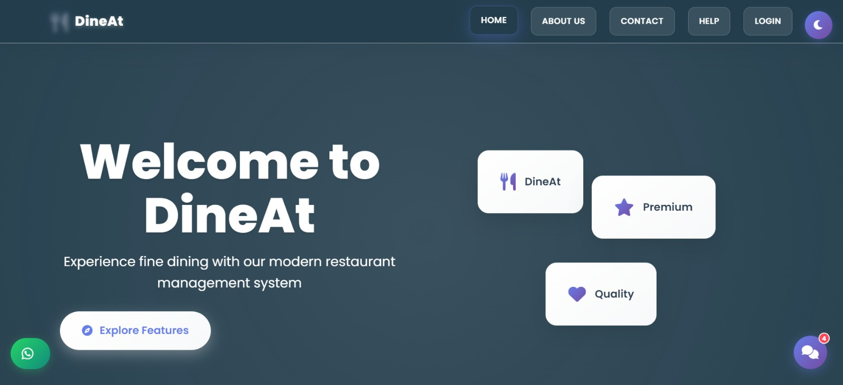
Home Page
Notes:
This slide, The speaker will talk about the content that we will be covering in this session as follows:
Introduction
Importance of UI/UX in industry
History and Definitions of UI and UX
Key Differences between UI/UX
Use Cases
Significance in Web Development
Use Cases
Visual Design Principles
Design process
Color theory and psychology
Typography and readability
Layout and Spacing
Responsive design basics
Usability and Accessibility
Usability Aspects
Web Content Accessibility Guidelines (WCAG)
Inclusive design practices
Consistency
User Experience
User-Centered Design
User research methods
Interactive Elements and Feedback
Mini Case Study
Discussing a popular UI/UX design
Hands-On
Introduction to Figma for UI/UX design

Slide 12
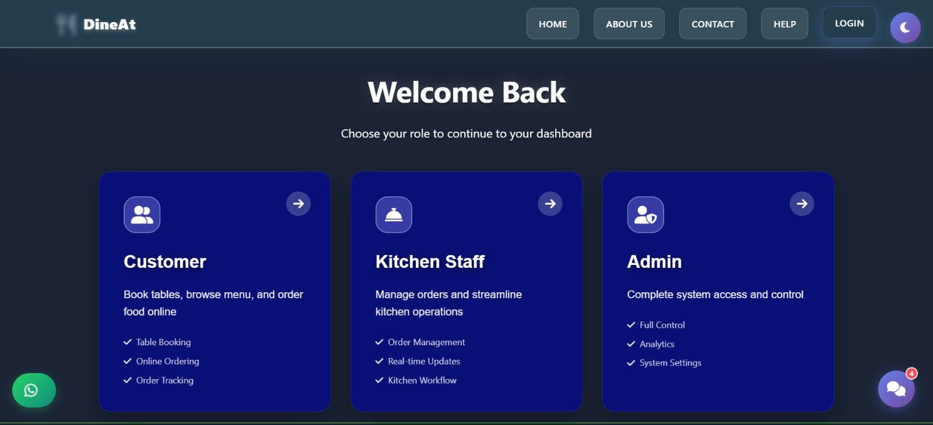
Login Page
Notes:
This slide, The speaker will talk about the content that we will be covering in this session as follows:
Introduction
Importance of UI/UX in industry
History and Definitions of UI and UX
Key Differences between UI/UX
Use Cases
Significance in Web Development
Use Cases
Visual Design Principles
Design process
Color theory and psychology
Typography and readability
Layout and Spacing
Responsive design basics
Usability and Accessibility
Usability Aspects
Web Content Accessibility Guidelines (WCAG)
Inclusive design practices
Consistency
User Experience
User-Centered Design
User research methods
Interactive Elements and Feedback
Mini Case Study
Discussing a popular UI/UX design
Hands-On
Introduction to Figma for UI/UX design

Slide 13
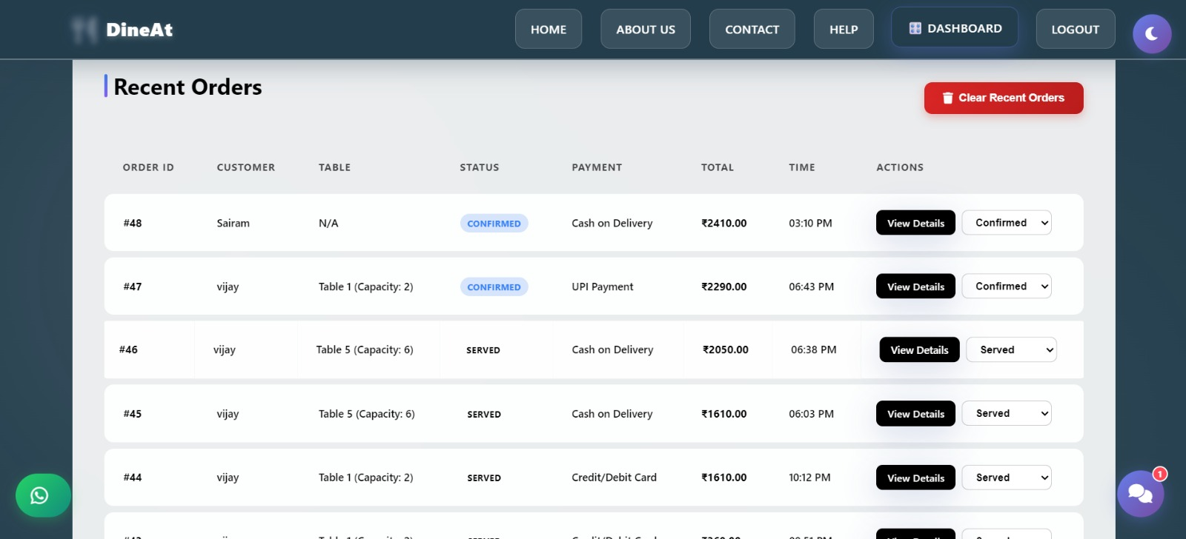
Dashboard
Notes:
This slide, The speaker will talk about the content that we will be covering in this session as follows:
Introduction
Importance of UI/UX in industry
History and Definitions of UI and UX
Key Differences between UI/UX
Use Cases
Significance in Web Development
Use Cases
Visual Design Principles
Design process
Color theory and psychology
Typography and readability
Layout and Spacing
Responsive design basics
Usability and Accessibility
Usability Aspects
Web Content Accessibility Guidelines (WCAG)
Inclusive design practices
Consistency
User Experience
User-Centered Design
User research methods
Interactive Elements and Feedback
Mini Case Study
Discussing a popular UI/UX design
Hands-On
Introduction to Figma for UI/UX design

Slide 14
Future Enhancement
Online reservation system integration
AI-based food recommendation system
Mobile application development
Online delivery and tracking feature
Analytics dashboard for business insights
Notes:
This slide, The speaker will talk about the content that we will be covering in this session as follows:
Introduction
Importance of UI/UX in industry
History and Definitions of UI and UX
Key Differences between UI/UX
Use Cases
Significance in Web Development
Use Cases
Visual Design Principles
Design process
Color theory and psychology
Typography and readability
Layout and Spacing
Responsive design basics
Usability and Accessibility
Usability Aspects
Web Content Accessibility Guidelines (WCAG)
Inclusive design practices
Consistency
User Experience
User-Centered Design
User research methods
Interactive Elements and Feedback
Mini Case Study
Discussing a popular UI/UX design
Hands-On
Introduction to Figma for UI/UX design

Slide 15
Conclusion
The Digital Food Ordering and Restaurant Management System provides an efficient solution to modernize restaurant operations by replacing manual processes with a digital platform. It simplifies ordering, improves communication between customers and kitchen staff, and reduces errors in order handling and payment management.
The system enhances customer experience through faster service and real-time order tracking while giving administrators complete control over restaurant activities. With its scalable and user-friendly design, the project offers a reliable and practical solution for improving overall restaurant efficiency.
Notes:
This slide, The speaker will talk about the content that we will be covering in this session as follows:
Introduction
Importance of UI/UX in industry
History and Definitions of UI and UX
Key Differences between UI/UX
Use Cases
Significance in Web Development
Use Cases
Visual Design Principles
Design process
Color theory and psychology
Typography and readability
Layout and Spacing
Responsive design basics
Usability and Accessibility
Usability Aspects
Web Content Accessibility Guidelines (WCAG)
Inclusive design practices
Consistency
User Experience
User-Centered Design
User research methods
Interactive Elements and Feedback
Mini Case Study
Discussing a popular UI/UX design
Hands-On
Introduction to Figma for UI/UX design

Slide 16
Reference
https://docs.djangoproject.com/en/stable/
https://www.python.org/doc/
https://dev.mysql.com/doc/
https://developer.mozilla.org/en-US/docs/Web
https://www.w3schools.com/html/
https://www.w3schools.com/css/
https://www.w3schools.com/js/
https://www.geeksforgeeks.org/django-tutorial/
https://www.tutorialspoint.com/django/index.html
https://getbootstrap.com/docs/
https://restfulapi.net/
https://owasp.org/www-community/attacks/csrf
Notes:
This slide, The speaker will talk about the content that we will be covering in this session as follows:
Introduction
Importance of UI/UX in industry
History and Definitions of UI and UX
Key Differences between UI/UX
Use Cases
Significance in Web Development
Use Cases
Visual Design Principles
Design process
Color theory and psychology
Typography and readability
Layout and Spacing
Responsive design basics
Usability and Accessibility
Usability Aspects
Web Content Accessibility Guidelines (WCAG)
Inclusive design practices
Consistency
User Experience
User-Centered Design
User research methods
Interactive Elements and Feedback
Mini Case Study
Discussing a popular UI/UX design
Hands-On
Introduction to Figma for UI/UX design

